Slide 1

Video Conferencing Application SIRIUS-MEET
OBJECT ORIENTED SOFTWARE DEVELOPMENT
REVIEW-2
OUR YOUTUBE VIDEO LINK:
https://www.youtube.com/watch?v=8ZwiekZ0a1o

Slide 2


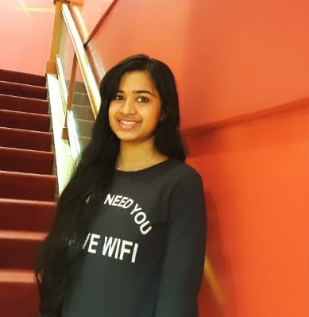
Our Team
S GIRISH
V MAHEYSH
V V VAISHNAVI

Slide 3
In today’s world of emerging technologies, education has experienced more advancements in many Universities and Institutions. Online learning is one of the imminent trends in the education sector around the globe.Attending online classes for one full semester created more productive digital workspace. Online learning also develops high quality learning opportunities and improve students’ outcomes and skills.
Our aim is to develop a video conferencing application like MS Teams, Zoom, Gmeet etc. This can be useful to conduct business meetings or personal video meeting during family functions providing a location independent lifestyle.
ABSTRACT

Slide 4

INTRODUCTION
Sirius-Meet is a Video Conferencing web application that will enable students to attend meetings online and interact with the faculties through their webcam. The application will provide the students a more comfortable environment with lower total costs, career advancements, geographic flexibility and more pacing options.

Slide 5


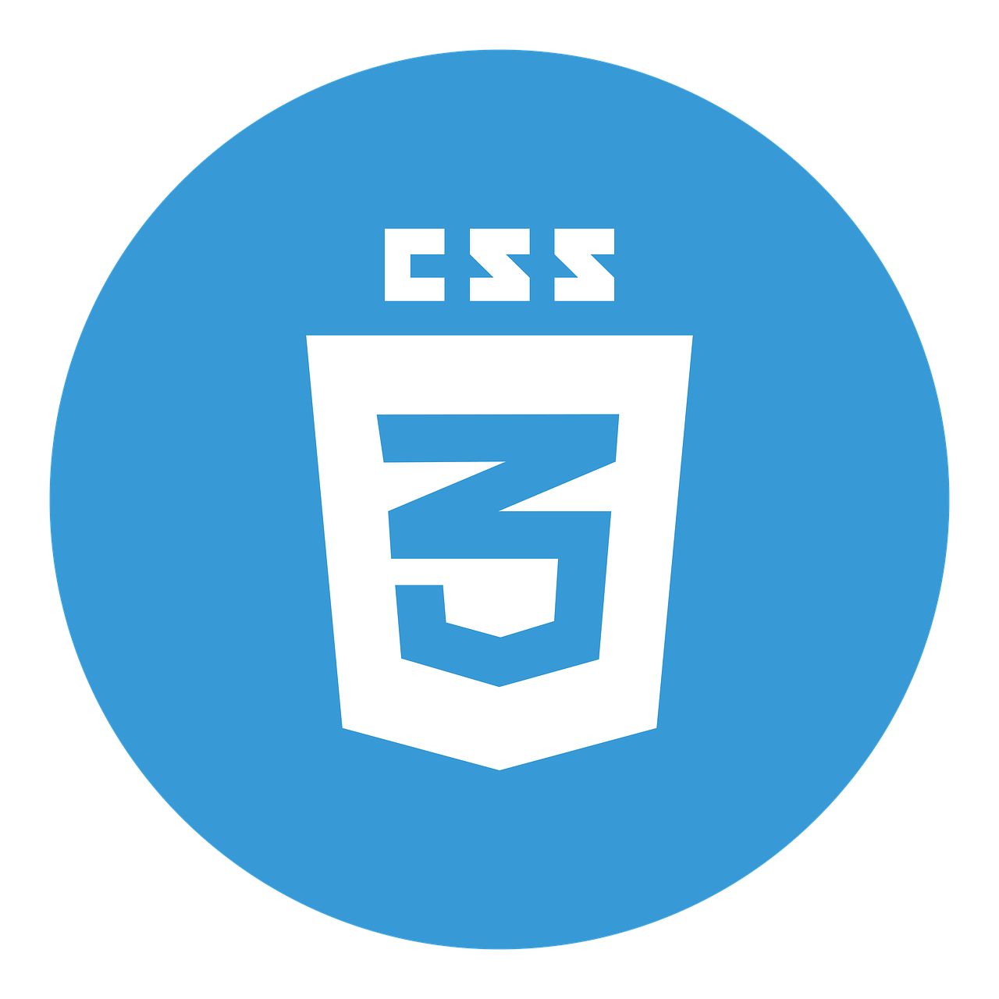

TOOLS AND TECHNOLOGIES
Javascript
HTML
Used for client-server connection and other main functionalities
Basic layout done using HTML
CSS
SOCKET IO
For real-time bidirectional communication
Used for styling the HTML document
This Photo by Unknown Author is licensed under CC BY-SA

Slide 6
MODULES
1
2
Video conference
Assignments
A client-server video connection is established for meetings.
The users are provided with Mute, unmute, screen share, video-on and video-off options
Files(assignments) will be uploaded by the students in this module. Teachers can download them for evaluation.

Slide 7
MODULES
3
4
White board
Chat Box
A white board for the faculty to write and explain the concepts clearly
A chat box where students can drop in their doubts for clarifications

Slide 8
SDLC MODEL
The iterative model is one of the model of software development life cycle that focuses on an initial, implementation, simplified which then progressive gains more complexity and broader feature until the final system is complete. Generally, iterative process starts with a simple implementation and iteratively enhances the system till the final system. Iterative model does not start with a full specification of the project.

Slide 9
WHY ITERATIVE MODEL?
Iterative model will be apt for SIRIUSMEET because each and every time on submitting our prototype in review, we may get to know different kind of features which we will be additionally learning in our project and also we might be removing few unnecessary features that the customer does not need. So, Iterative model will be Suitable for our project.
Other advantages:
• Generates working software quickly and early during the software life cycle.
• Results are obtained early and periodically.
• Progress can be measured.
• More feasible-less cost to change scope and requirements.
• Risks and identified and resolved during iteration; and each iteration is an easily
managed milestone.

Slide 10
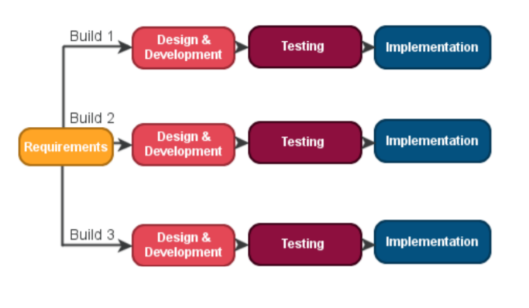

Slide 11
SOFTWARE ARCHITECTURE
The call and return architectural style is characterized by viewing a system as a main entity which can call smaller sub-entities to perform an action. The outcome of this action is returned to the main entity. A call and return architecture will enable software designers to achieve a program structure, which has the following features:
–Modifiability, indicating that one of the sub-systems can be easily modified
–Modifiability, indicating that one of the sub-systems can be easily modified without
influencing other sub-systems.
–Scalability, indicating that the system can handle an increased or decreased in the number of
users, without affecting the function of system
This substyle used is Main program/subprogram architecture. Here, the function is
decomposed into a control hierarchy where the main program invokes a number of program
components, which in turn may invoke other components.

Slide 12
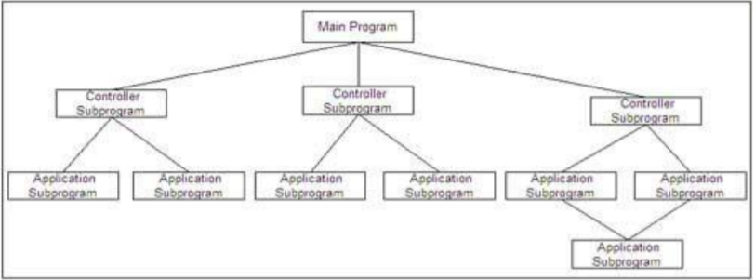
WHY THIS ARCHITECTURE?
Our project follows this architecture. A node.js server acts as the main program, which in turn makes calls to other HTML pages. The required page is returned as and when the user requires it. This architectural design was useful during design of the projects as the subprograms could be developed and tested independently of the other components. For instance, testing out if the video stream was optimal on the meeting page could be done independently, just by linking it with the node.js server.
This architectural design is also useful to isolate and debug failures during runtime. Since the subprograms are modular, errors can be identified and debugged easily. As a video conferencing system will need to handle a varying load, abiding by the scalability provided in this model is essential.

Slide 13
DESIGN PATTERN
Builder pattern builds a complex object using simple objects and using a step by step approach. This type of design pattern comes under creational pattern as this pattern provides one of the best ways to create an object. A Builder class builds the final object step by step. This builder is independent of other objects. In our project, a step by step process takes place as we first enter our name before joining the meet. After joining the meet, the meeting occurs. Mute, unmute and screenshare are built by the video Meeting module. This is followed by other steps of uploading files, whiteboard. In the final step when the code is executed, the model is deployed.

Slide 14
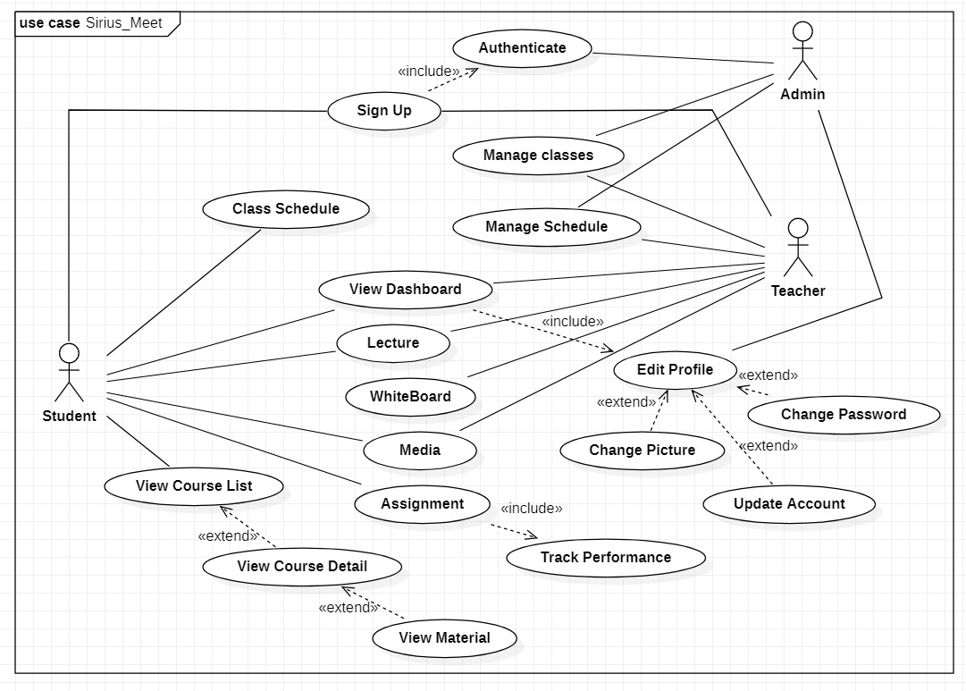
USE CASE DIAGRAM

Slide 15
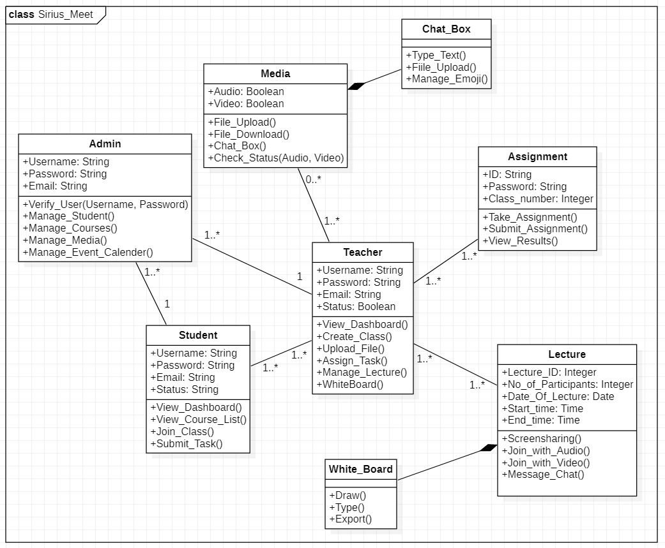
CLASS DIAGRAM

Slide 16



OUR YOUTUBE VIDEO LINK:
https://www.youtube.com/watch?v=8ZwiekZ0a1o
GITHUB LINK:
https://github.com/Iris6373/VITMeeT

